Slide 1
Parcel sorting system
Priority queue

Slide 2
Introduction
This C program implements a priority queue system for managing parcels using a linked list. Each parcel has a name and a priority level (1 = Urgent, 2 = Normal, 3 = Low). Parcels are enqueued into the list based on their priority, ensuring that higher-priority parcels are always positioned ahead of lower-priority ones.Key functionalities include:
Enqueue: Add a parcel to the queue according to its priority.
Dequeue: Remove and deliver the parcel with the highest priority (smallest priority number).
Display: Show all parcels currently in the queue along with their priorities .
The program demonstrates these features by inserting several parcels, displaying the queue, delivering two parcels, and then showing the remaining parcels

Slide 3
Objective
The objective of this program is to implement a priority queue system for managing parcel deliveries using a singly linked list in C. The program organizes parcels based on their priority levels—Urgent, Normal, and Low—ensuring that parcels with higher priority are delivered first. It provides essential operations such as inserting parcels according to their priority (enqueue), delivering the highest-priority parcel (dequeue), and displaying the current list of parcels. This system simulates an efficient, priority-based delivery management process

Slide 4
Why C Language?
Efficiency: C provides low-level access to memory and hardware, making programs fast and efficient — important for systems like parcel management where performance can matter.
Control: It allows fine control over data structures like linked lists, which are manually managed in this program for priority queue handling.
Simplicity: C is straightforward and ideal for learning and implementing fundamental concepts such as dynamic memory allocation, pointers, and data structures.
Portability: Programs written in C can easily run on different machines with minimal changes.

Slide 5
Why Data Structures and Algorithms
Efficient Problem Solving: DSA provides the techniques needed to organize and manage data efficiently, leading to faster and more optimized solutions .
Proper Data Management: Using structures like linked lists helps to store, retrieve, and update parcel information dynamically and systematically .
Priority Handling: Algorithms are essential for maintaining the priority-based order in the queue, ensuring urgent parcels are delivered first.

Slide 6
Algorithm
Step 1: Start
Step 2: Define structure Parcel • Fields: name, priority, next
Step 3: Initialize front = NULL
Step 4: Define createParcel(name, priority) • Create new parcel node and return it
Step 5: Define enqueue(name, priority) • If queue is empty or new parcel has higher priority → insert at front • Else, find correct position and insert based on priority
Step 6: Define dequeue() • If queue is empty → print "No parcels to deliver" • Else → remove and display the front parcel
Step 7: Define display() • Traverse from front and print all parcels
Step 8: In main: • Add parcels with different priorities using enqueue() • Display queue • Deliver parcels using dequeue() • Display remaining parcels
Step 9: End

Slide 7
What We Have Learned from This Code
Priority Queue Implementation:
We learned how to implement a priority queue using a singly linked list in C, where items are arranged based on their priority.
Dynamic Memory Management:
We practiced using malloc and free to create and delete nodes dynamically at runtime, helping us manage memory efficiently.
Linked List Traversal and Manipulation:
We understood how to traverse, insert, and delete nodes in a linked list, maintaining a sorted order based on a specific condition (priority).

Slide 8

Source code
https://www.onlinegdb.com/online_c_compiler

Slide 9
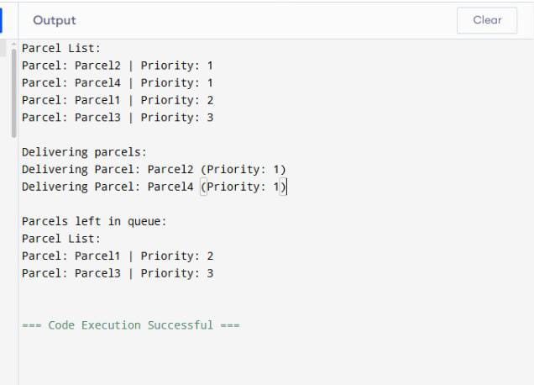
Output

Slide 10

THANK YOU
Team members :K.Sumavalli(24KB1A05S2)
K.Keerthi (24KB1A05T1)
K.Nandhini(24KB1A05Q5)
K.Triveni(24KB1A05S7)

